Slide 1
Using Symmetrical Pumping to Manage Hydraulic Transients
Robert Miller
Marafeq Qatar
Robert.miller@marafeq.com.qa
Ola Rossing
Hydroram
Ola@hydroram.se

Slide 2
About the Investigators
The Author
Robert Miller, Technical Specialist District Cooling with Marafeq Qatar
Mechanical engineer serving the district energy industry since 1978
Analysis and design of district heating and cooling piping and building connections
Master of Science in Mechanical Engineering from New Mexico State University, Bachelor of Science in Mechanical Engineering from Columbia University and Bachelor of Arts degree in Physics from Augustana College.
Registered professional engineer in Iowa and Minnesota, USA
One of the principal authors of IDEA’s District Cooling Best Practice Guide for Middle Eastern Projects
The Analyst
Ola Rossing, president and founder of Hydroram AB
25 years’ experience solving complex hydraulic problems
Modeling results validated through actual experience over several decades
Serves more than two-thirds for both district heating and district cooling systems in Sweden
Holds workshops to educate engineers and operators, because without a firm understanding of hydraulic principles, it is easy to misapply them with unpleasant results.
More than a thousand people have participated in Hydroram courses
of 17

Slide 3
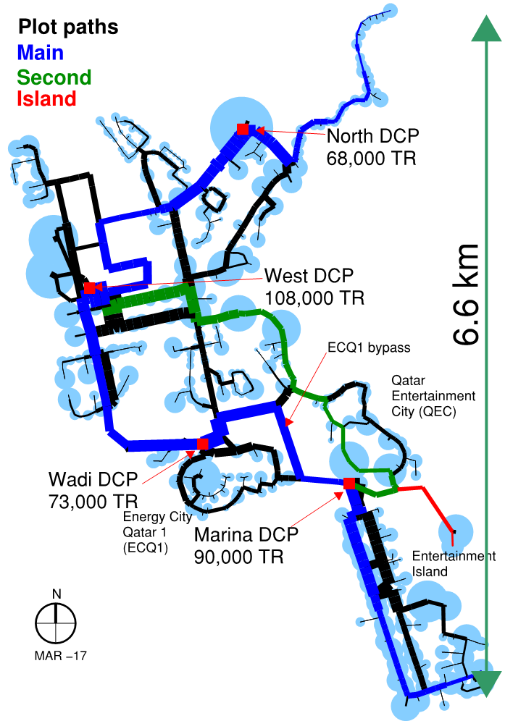
The Challenge?
~340,000 TR
Four plants
All with TES tanks
170 km supply and return
DN 200 to DN 1600
of 17
Notes:
Netsim base model Vitec
Translated into Hydroram proprietary software
The lines represent flow paths between plants

Slide 4
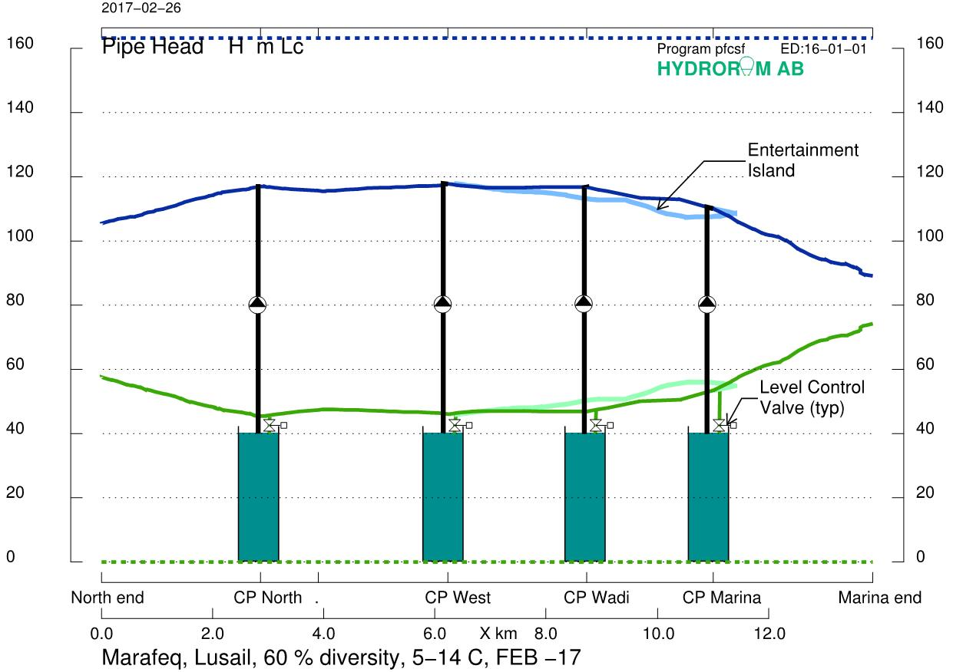
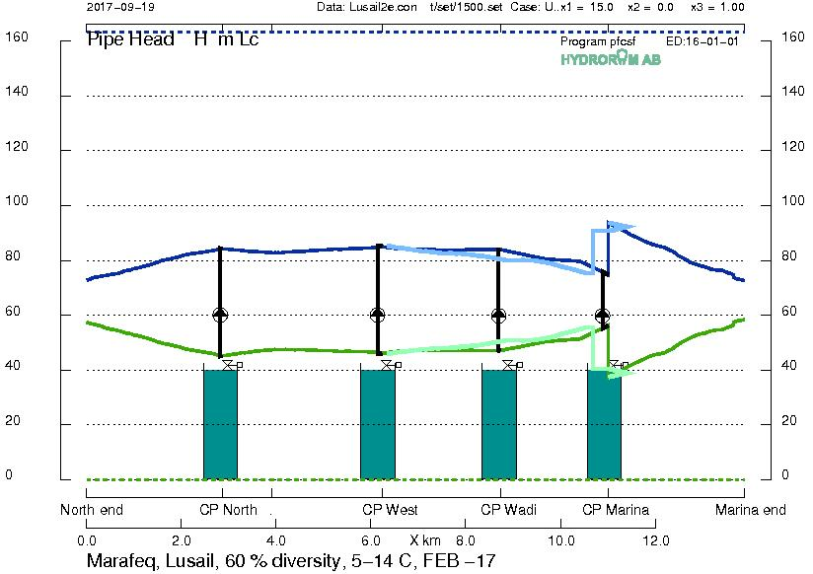
Marina Booster Pumps
Without booster pumps: 24.5 MW
With booster pumps: 16.4 MW
Power reduction: 8.1 MW
of 17
Notes:
Before I jump into the discussion I wanted to start with the Marina booster pumps

Slide 5
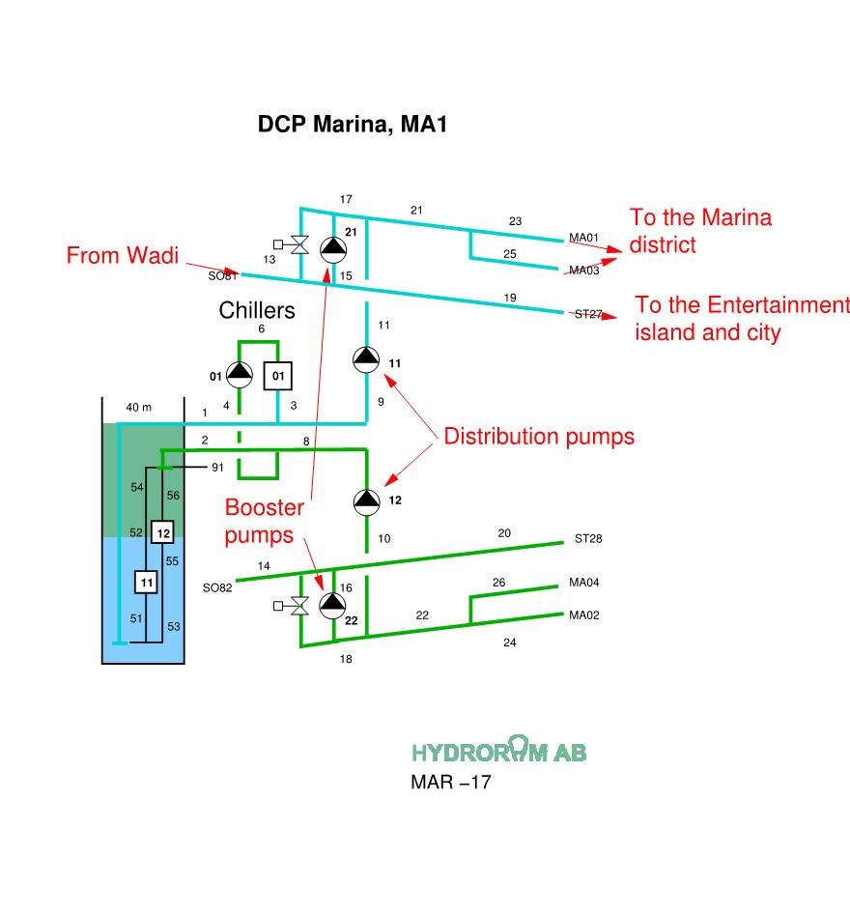
Marina Booster Pumps
Load < capacity; no booster
Load > capacity close bypass; run booster pumps to meet critical customer
of 17
Notes:
Before I jump into the discussion I wanted to start with the Marina booster pumps

Slide 6
Single Pumping without TES
Transients are manageable
Maximum pressure is reasonable
System pressure is all above the suction pressure
Minimum pressure held at pump suction
of 17

Slide 7
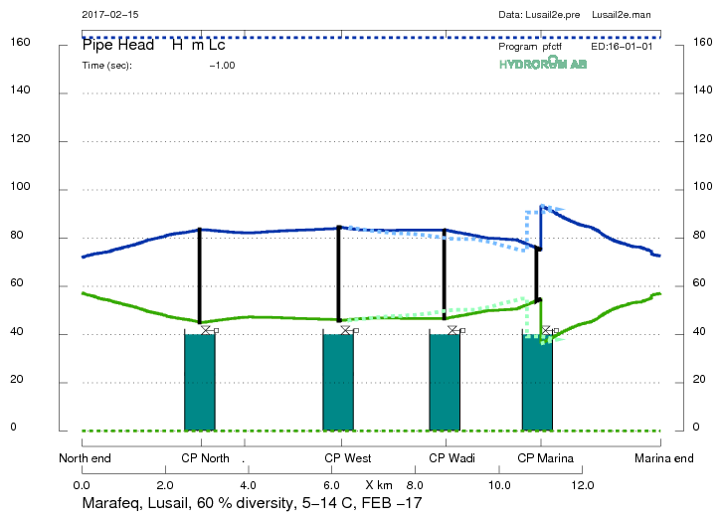
Single Pumping with TES
Transients are extreme
Maximum pressure is greater
System pressure is all above the suction pressure
Minimum pressure held by tank level
of 17

Slide 8
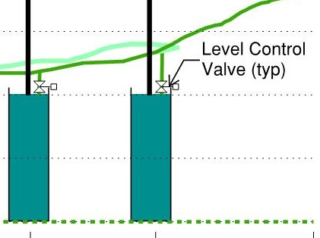
Tank Level Control
System pressure above tank level varies
Set one plant as “static” tank
Manage levels in all the others
of 17

Slide 9
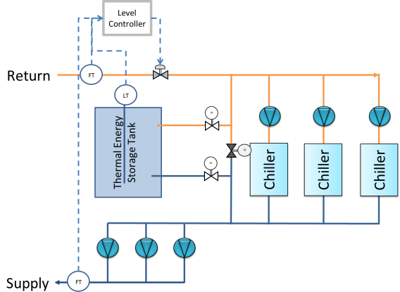
Tank Level Control
DN 1600 at West DCP
Flow in must = out
Measure both and adjust LCV
Use LT to trim valve position set point
of 17

Slide 10
Extreme Transients
of 17

Slide 11
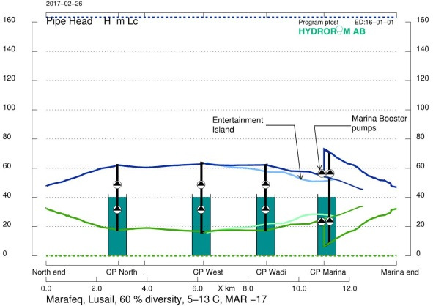
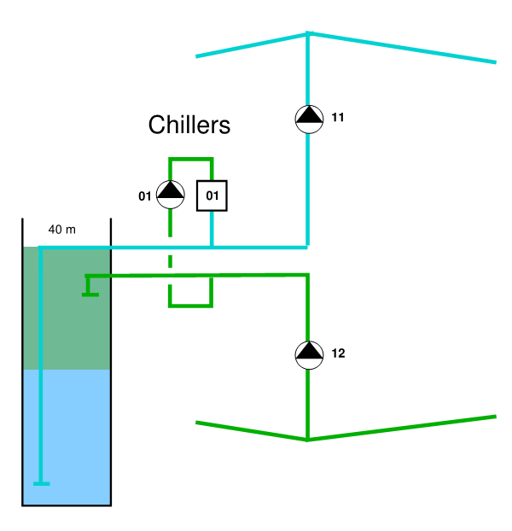
Symmetrical Pumping
Pumps work in pairs
Speed change applies to both
One fails, shut other down
Within 1 second
of 17

Slide 12
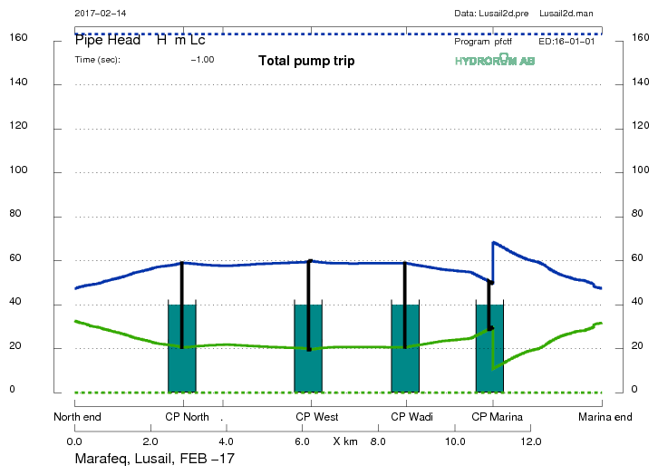
Symmetrical Pump with TES
of 17

Slide 13
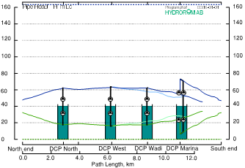
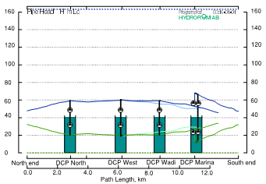
Usable DP Constrained by Static
8C delta T
9C delta T
of 17

Slide 14
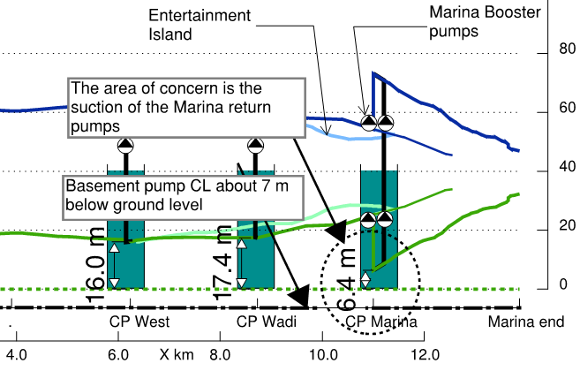
Minimum Pinch Point
of 17

Slide 15
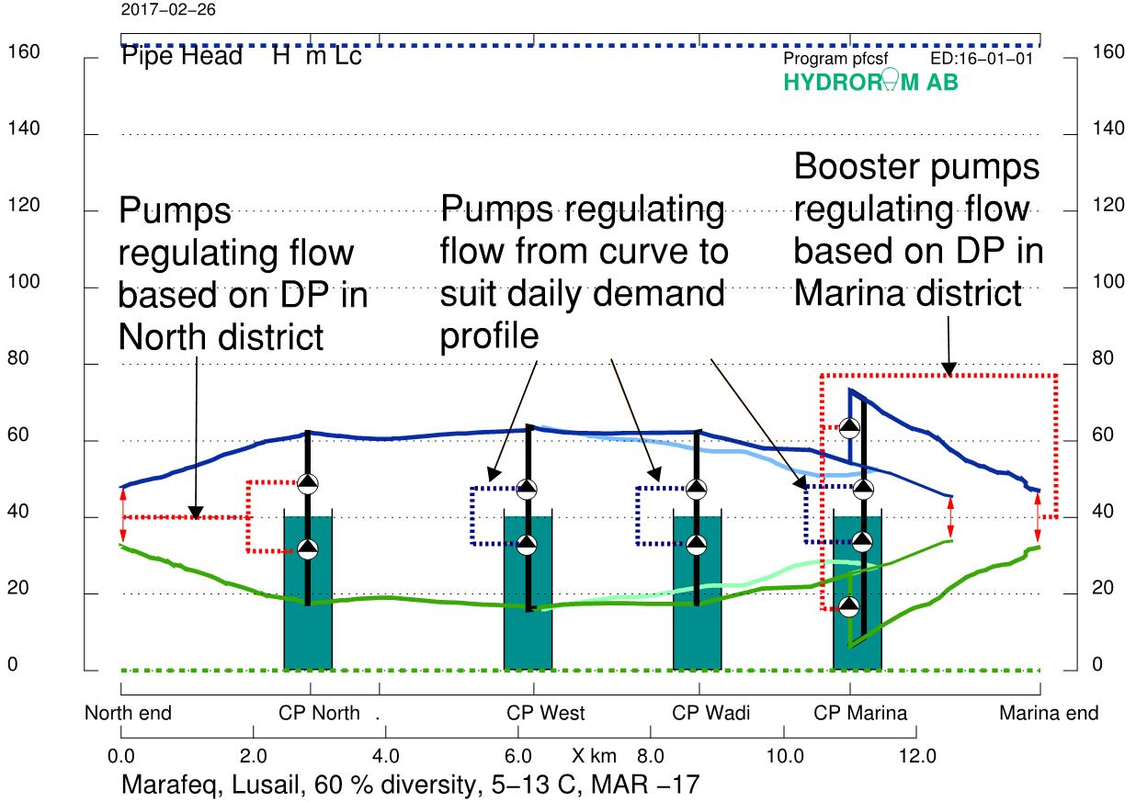
Plant Regulation Strategy
of 17

Slide 16
Transients—Single Pump
In system without TES, single pump is fine
In system with multiple tanks, - single is risky
of 17

Slide 17
Transients—Symmetrical
Symmetrical pumping provides safe and efficient operation
of 17

